Slide 1

ASL Recognition using Data Parallelism and PyTorch
Nikunj Lad
001422467

Slide 2
Motivation
We are privileged as humans to talk and converse and communicate with each other.
What about those people who can’t talk or speak?
There are about 0.7 to 0.8 million people in the world who are mute/deaf and who are not as privileged like us.
How can we make the lives of this people easier?

Slide 3
Background
Prior to the advent of deep learning we had traditional methods like SURF and SIFT.
SURF is the speed up version of SIFT. SURF goes a little further and approximates Laplacian of Gaussian with Box Filter.
Also, since 2012 (after the famous AlexNet), the rise in deep learning algorithms being implemented on GPU’s has risen exponentially.

Slide 4
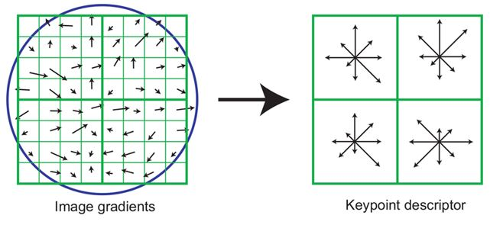
SURF-SIFT
The scale-invariant feature transform (SIFT) is an algorithm used to detect and describe local features in digital images.
Locates key points and furnishes them with quantitative information.
A SIFT feature is a selected image region (also called key point) with an associated descriptor. Key points are extracted by the SIFT detector and their descriptors are computed by the SIFT descriptor.

Slide 5
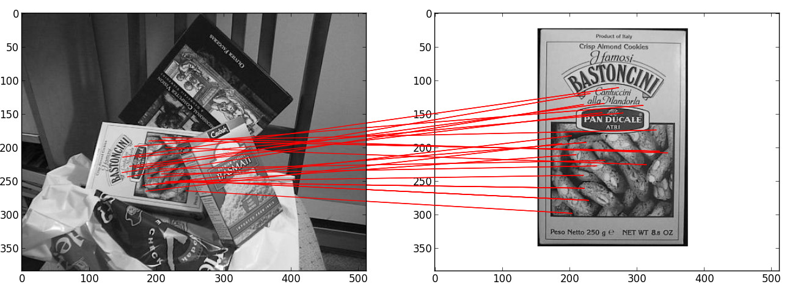
SURF-SIFT Matching

Slide 6
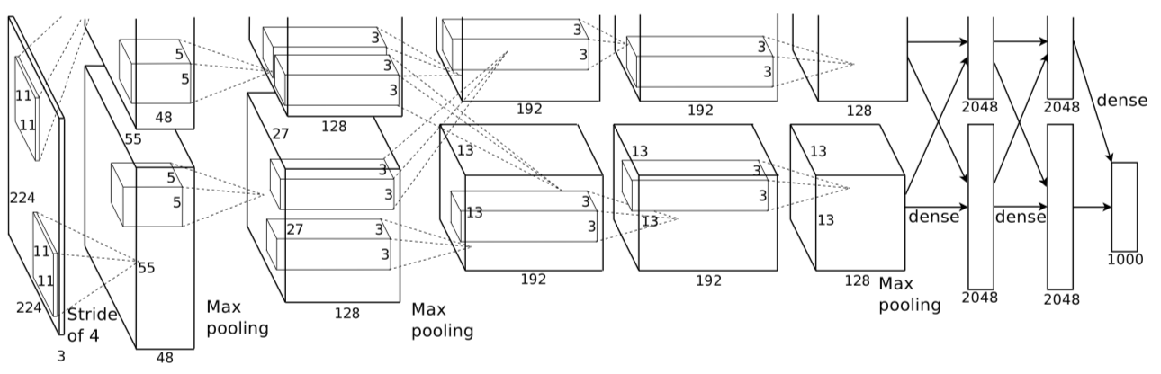
AlexNet Architecture

Slide 7
Objectives
Hypothesis 1: We can recognize hand signs from images or stream of images using state of the art techniques.
Hypothesis 2: Using more GPU’s always speeds up computation and saves time.
Hypothesis 3: Larger batch size means better model approximation.
Hypothesis 4: Keeping number of GPUs constant, there exists a linear relationship between number of batches and time taken. In short, as number of batches increases, time decreases.

Slide 8
System Specifications
Cluster: Discovery High-Performance Computing Cluster
Reservation: CSYE7374_GPU
Reservation memory: 95 GB
Time reserved: 10 hrs.
GPU
Model: Nvidia V100-SXM2
GPU count: 0 – 4
GPU Memory: 32.4805 GB / GPU
Clock: 1.290Ghz with max boost of 1.530GHz

Slide 9
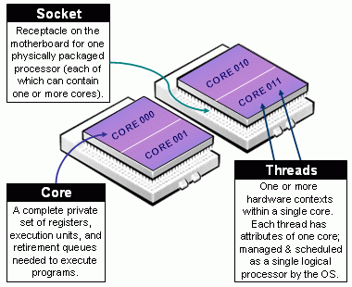
System Specifications
CPU
Model: Intel(R) Xeon(R) Gold 6132 CPU @ 2.60GHz
Sockets: 2
Cores/socket: 14
Threads/core: 1
CPUs: 28

Slide 10
Commands
Command to enter reservation
srun -p reservation --reservation=CSYE7374_GPU --gres=gpu:v100-sxm2:4 --pty --mem=95000 --time=10:00:00 /bin/bash
Command for getting GPU information
nvidia-smi -q -d CLOCK & watch –n 0.1 nvidia-smi
Command for getting CPU information
lscpu

Slide 11
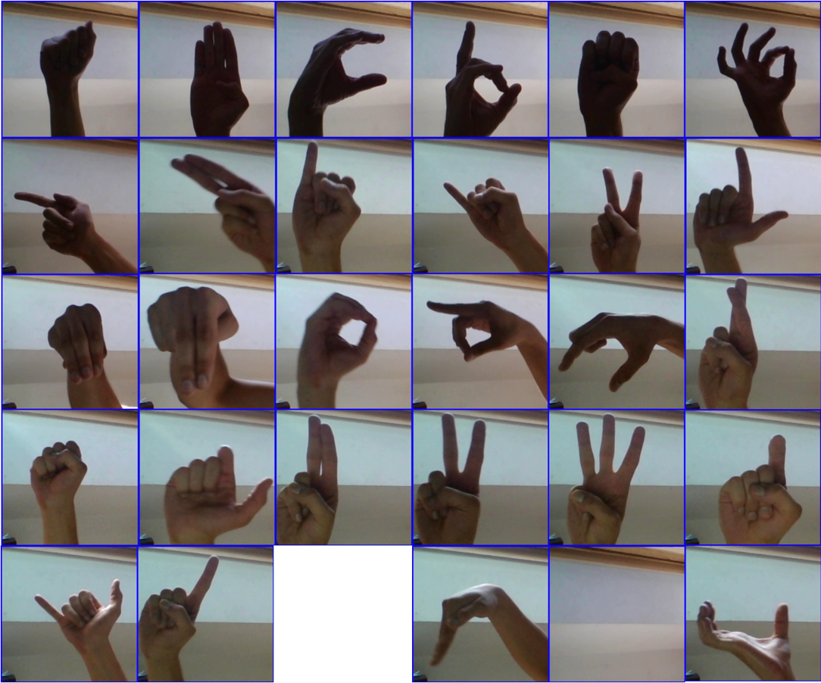
Dataset Specifications
89029 images in total in the dataset
Each image is 200x200x3 in resolution and it is resized to 150x150x3 size for performance benefits.
26 alphabets and 3 special characters (del, nothing and space)
76760 images for training, 8528 for validation and 1741 for testing.
Generated .h5 files and data was segregated into folders from A to Z.

Slide 12
Methodology
Net (
(conv1): Conv2d (3, 8, kernel_size= (7, 7), stride= (1, 1))
(conv2): Conv2d (8, 16, kernel_size= (5, 5), stride= (1, 1))
(conv3): Conv2d (16, 4, kernel_size= (3, 3), stride= (1, 1))
(fc1): Linear (in_features=1024, out_features= 512, bias=True)
(fc2): Linear (in_features=512, out_features= 29, bias=True)
(norm4): BatchNorm2d (4, eps=1e-05, momentum=0.1, affine=True, track_running_stats=True)
(norm8): BatchNorm2d (8, eps=1e-05, momentum=0.1, affine=True, track_running_stats=True)
(norm16): BatchNorm2d (16, eps=1e-05, momentum= 0.1, affine=True, track_running_stats=True)
(pool): MaxPool2d (kernel_size=(2, 2), stride=(2, 2), padding=0, dilation=1, ceil_mode= False)
(dropout): Dropout (p=0.2, inplace=False)
)

Slide 13
Block Diagram
Input Image (150x150x3)
Conv1 (7x7x8)
Max-Pooling (2x2x8)
Batch Norm (72x72x8)
Conv3 (3x3x4)
Batch Norm (34x34x16)
Max-Pooling (2x2x16)
Conv2 (5x5x16)
Max-Pooling (2x2x4)
Batch Norm (16x16x4)
FC1 (1024)
FC2 (512)
Out (29)

Slide 14
Why did we choose this architecture?
Total Layers: 5-layer architecture with Batch Normalization after every layer.
Firstly because, state-of-the-art models require 227x227 or 224x224 dimensional images as inputs.
They are very deep, and our dataset is not so complex to have such deep architectures.
They can lead to overfitting and may cause vanishing gradient problems.

Slide 15
Analysis
We aim to exploit the second objective of our project in the analysis section.
What is the time consumed by GPUs on 128, 256, 512 batch size of images?
What is the memory consumption of the GPUs using the above batch sizes?
How do we have a reasonable tradeoff in performance time and batch size by selecting an optimal number of GPU and data batches.

Slide 16
Assumptions and Constants
Training split to 76760 images, validation split to 8528 images and testing split to 1741 images.
Number of epochs: 25 (since changing them will cause run time variations)
Learning rate: 0.005 (this will affect how fast or slow network converges and since early stopping is disabled, hardly will affect our analysis, since we will run for the entire 25 epochs).
Optimizer: Stochastic Gradient Descent (based on empirical results)
Activation: ReLU (faster computation since reduces run time by ~25%).

Slide 17
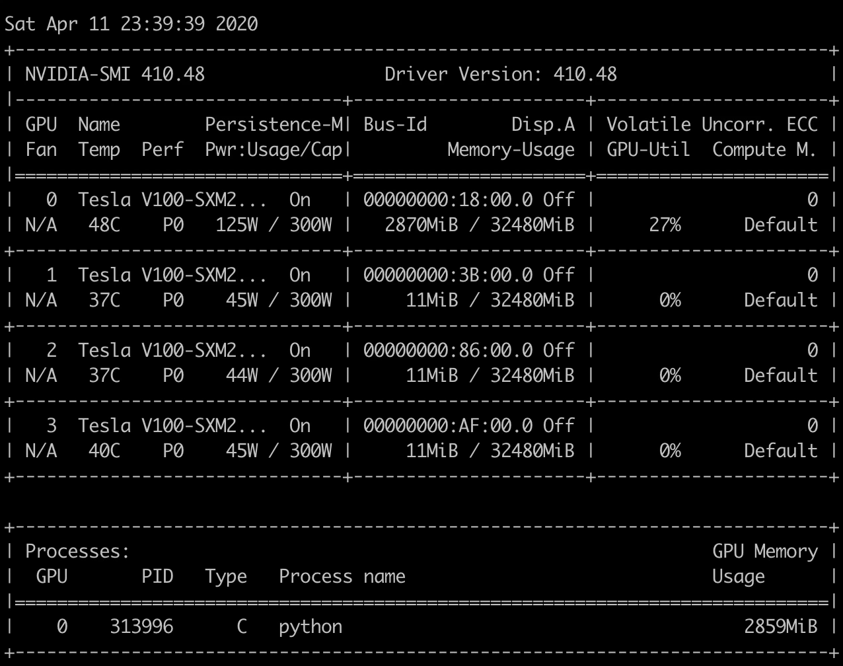
Experiment 1
Batch size: 128
GPU=1
Data Parallelism = No Training: 600
Validation: 67
Testing: 14

Slide 18
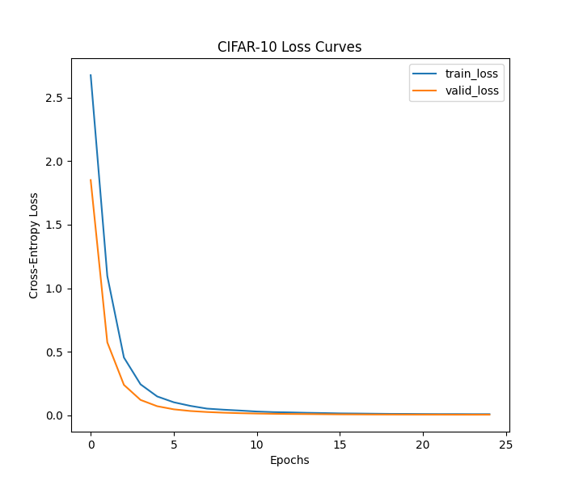
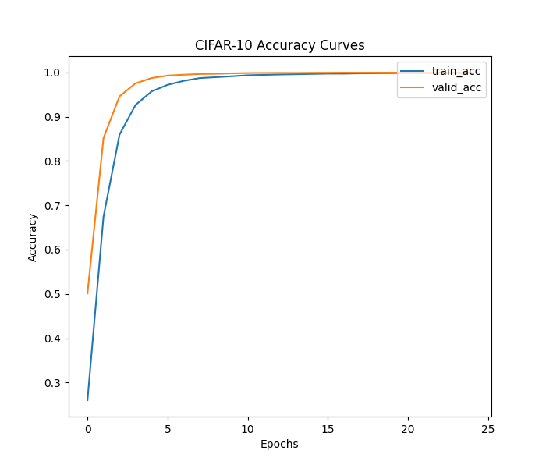
Exp1: 128 batch-size, 1GPU

Slide 19
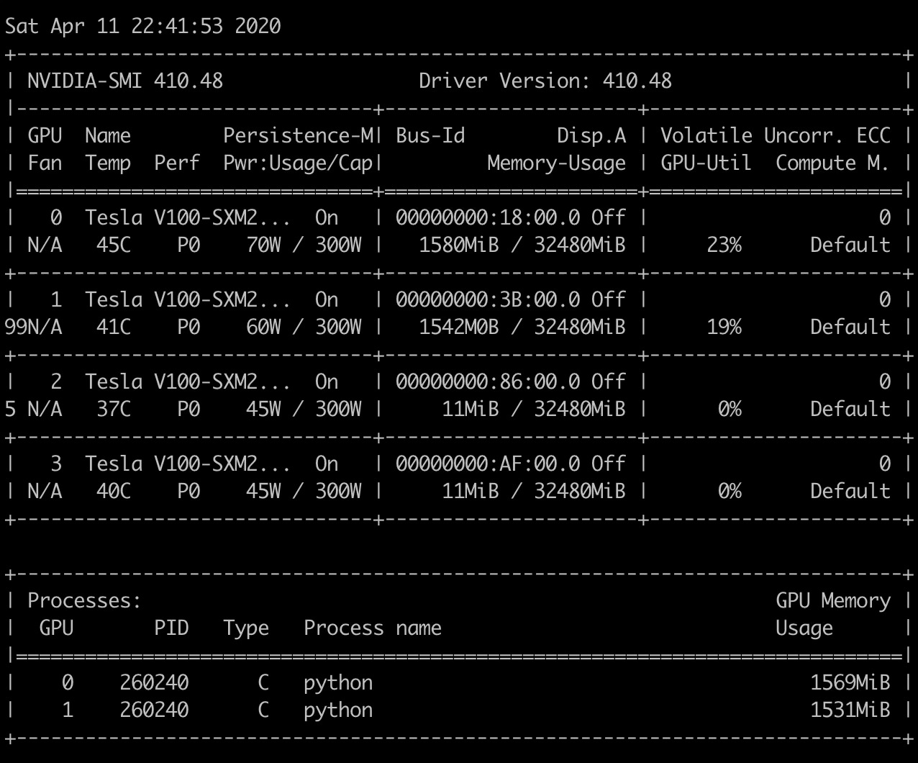
Experiment 1
Batch size: 128
GPU=2
Data Parallelism = Yes Training: 600
Validation: 67
Testing: 14

Slide 20
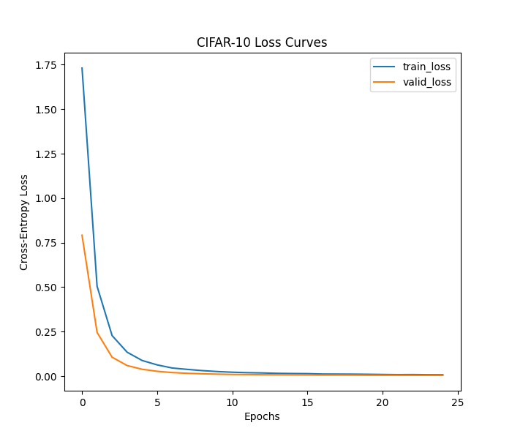
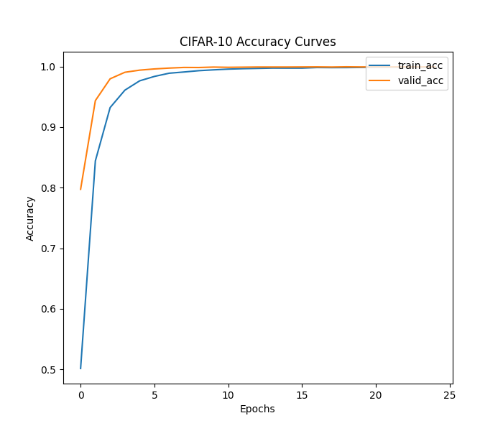
Exp1: 128 batch-size, 2GPUs

Slide 21
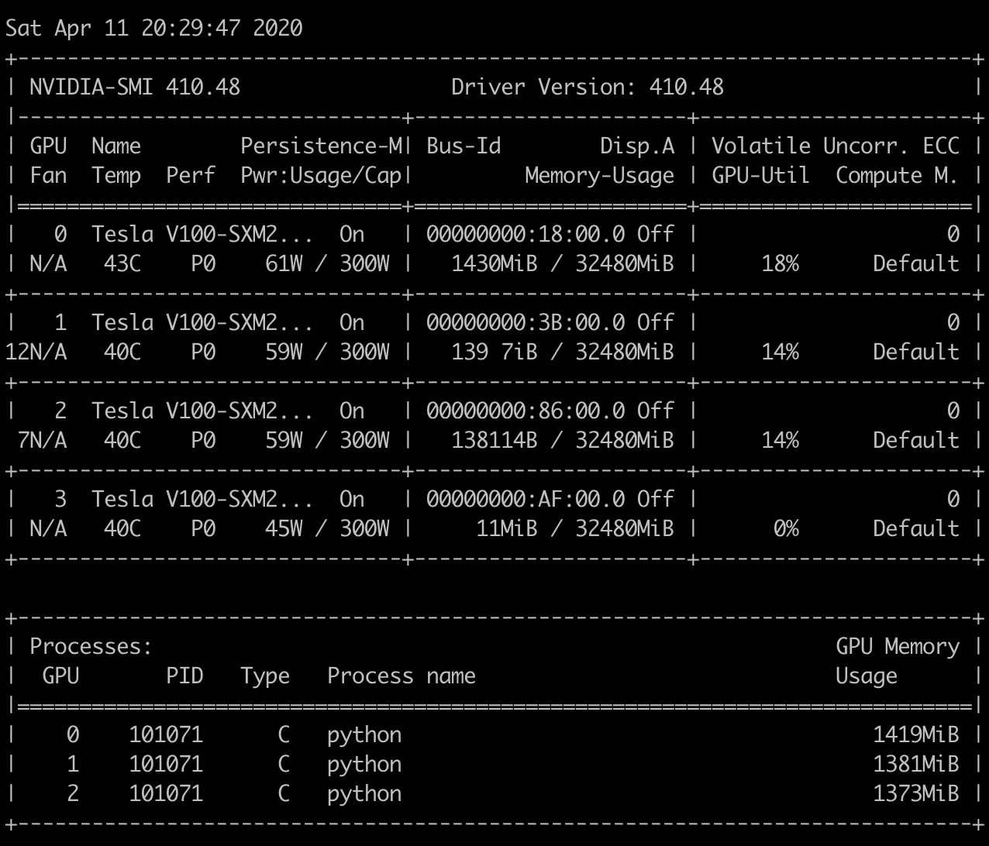
Experiment 1
Batch size: 128
GPU=3
Data Parallelism = Yes Training: 600
Validation: 67
Testing: 14

Slide 22
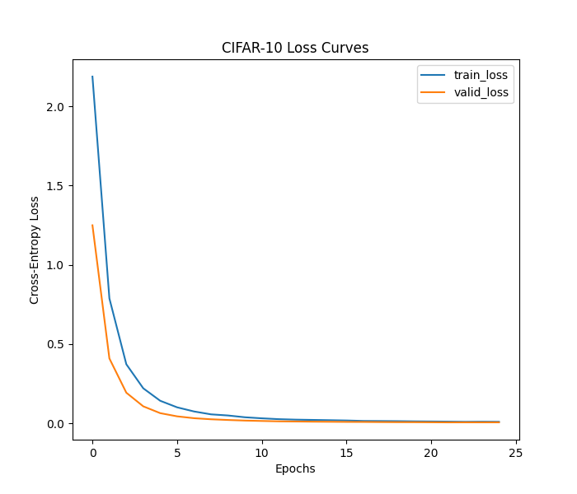
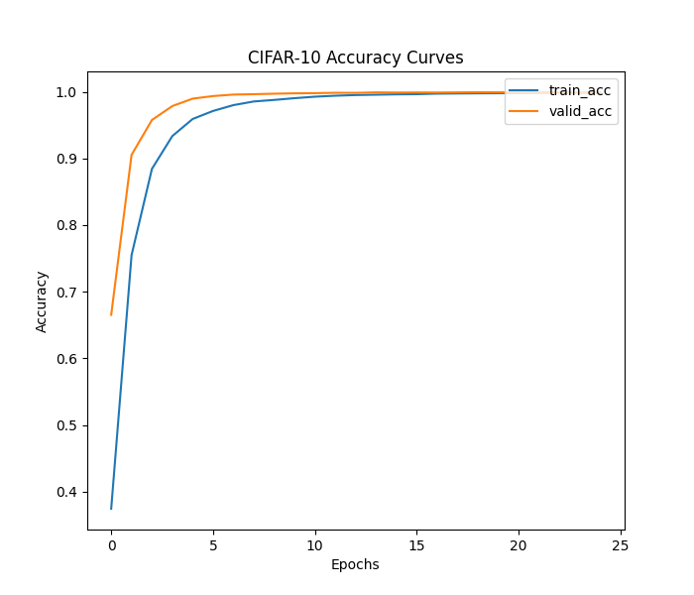
Exp1: 128 batch-size, 3GPUs

Slide 23
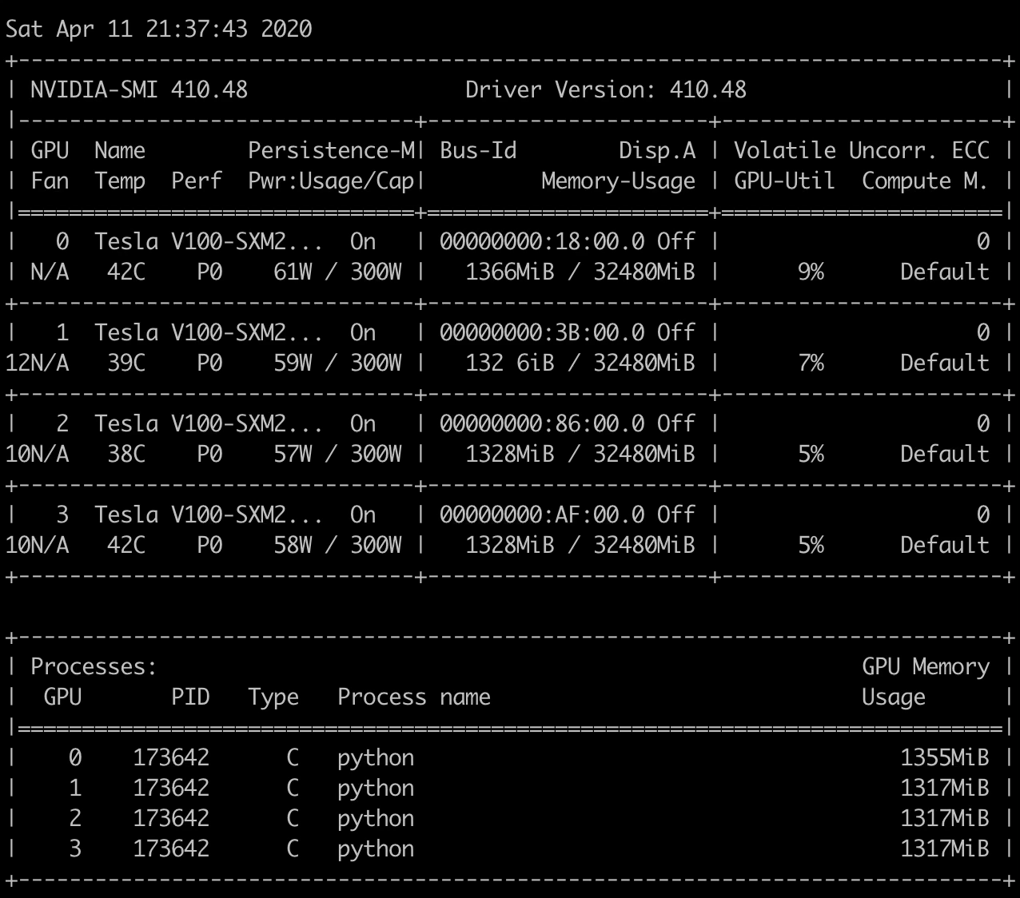
Experiment 1
Batch size: 128
GPU=4
Data Parallelism = Yes Training: 600
Validation: 67
Testing: 14

Slide 24
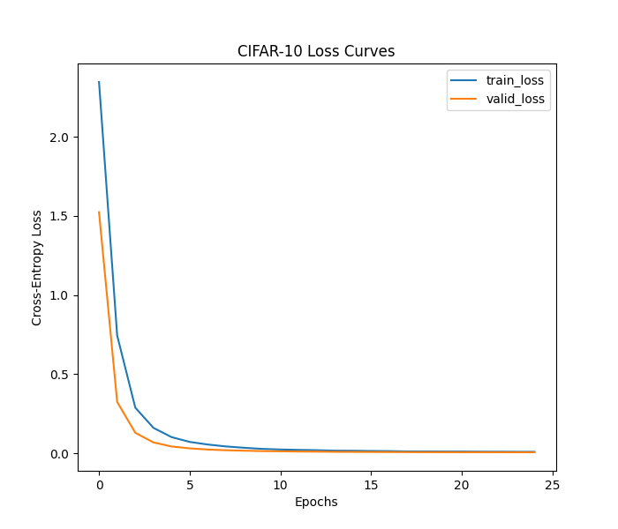
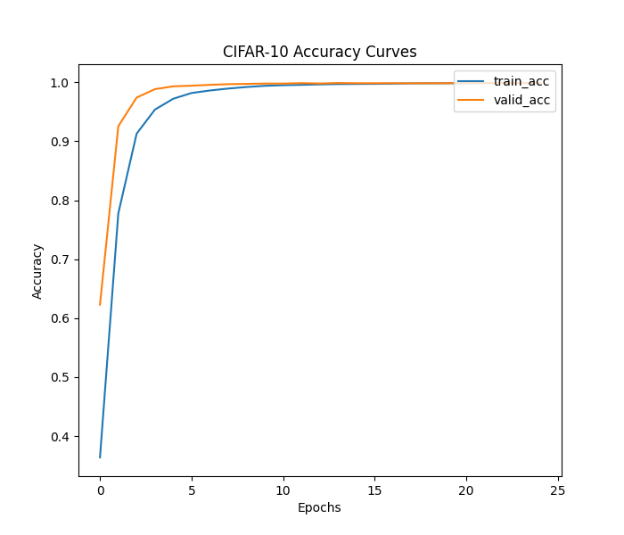
Exp1: 128 batch-size, 4GPUs

Slide 25

Experiment 2
Batch size: 256
GPU=1
Data Parallelism = No Training: 300
Validation: 34
Testing: 7

Slide 26
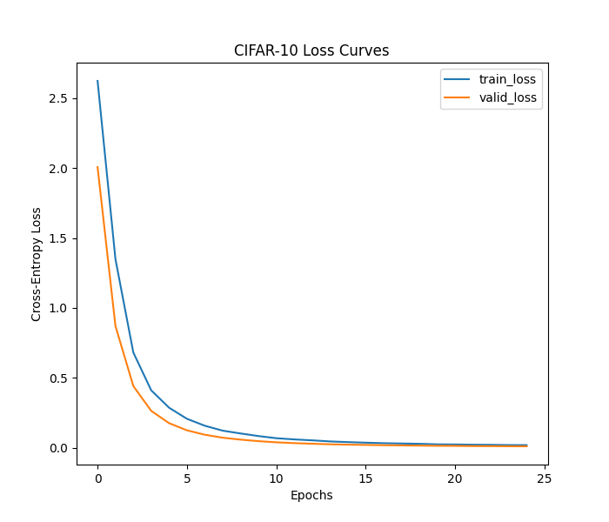
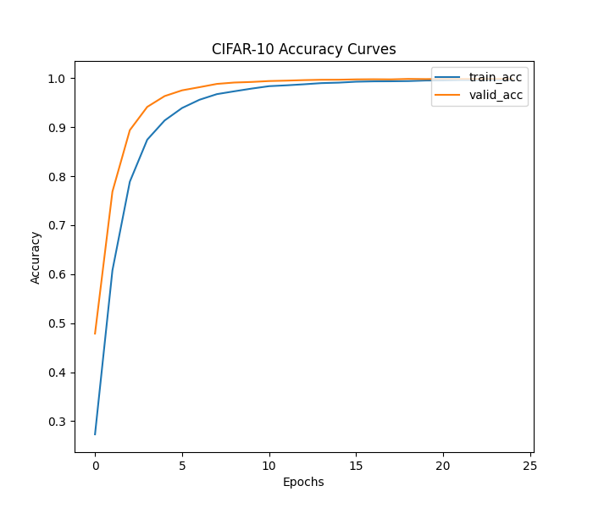
Exp2: 256 batch-size, 1GPU

Slide 27
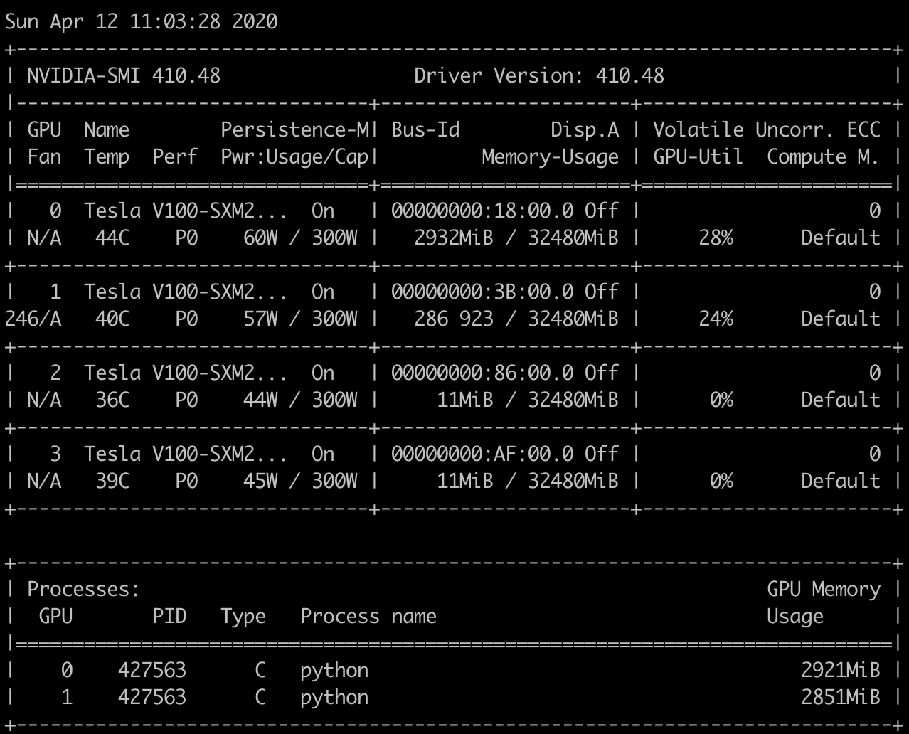
Experiment 2
Batch size: 256
GPU=2
Data Parallelism = Yes Training: 300
Validation: 34
Testing: 7

Slide 28
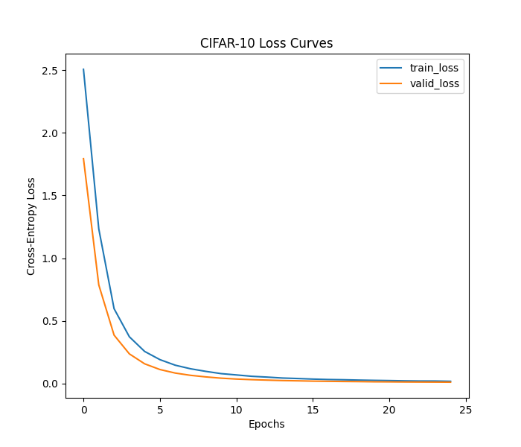
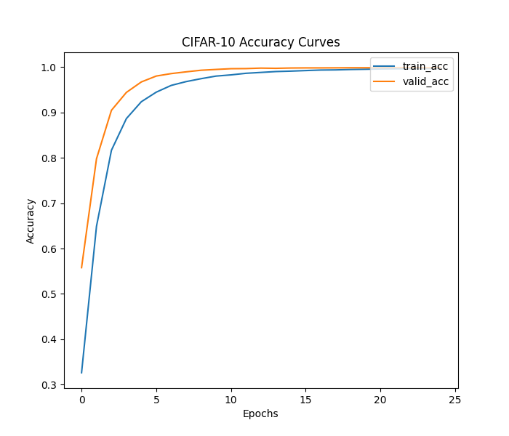
Exp2: 256 batch-size, 2GPUs

Slide 29
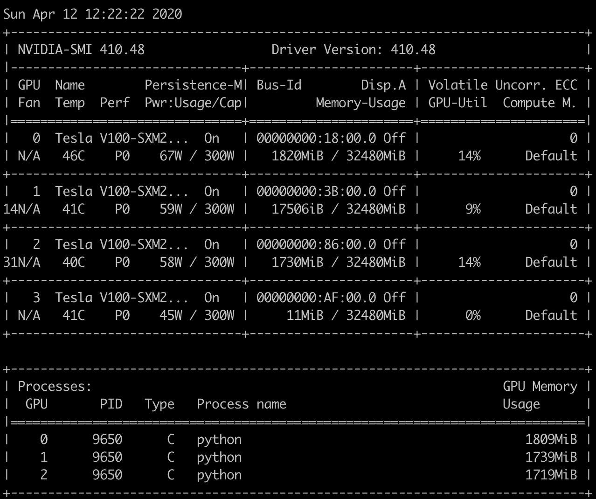
Experiment 2
Batch size: 256
GPU=3
Data Parallelism = Yes Training: 300
Validation: 34
Testing: 7

Slide 30
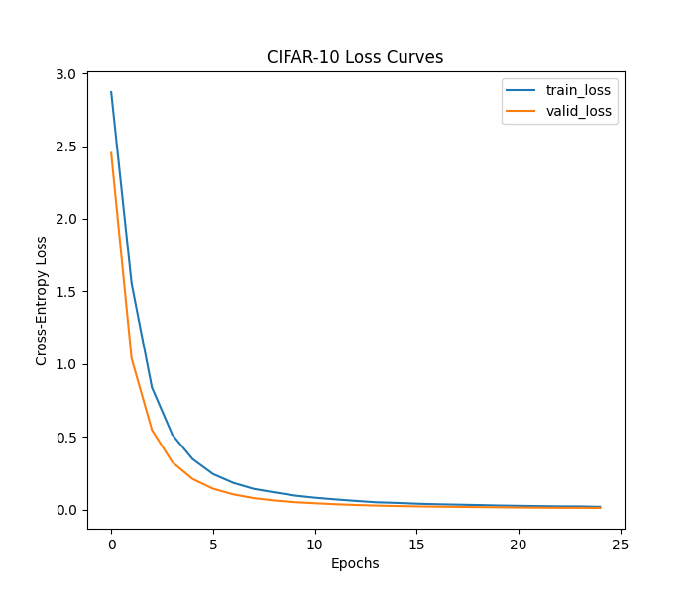
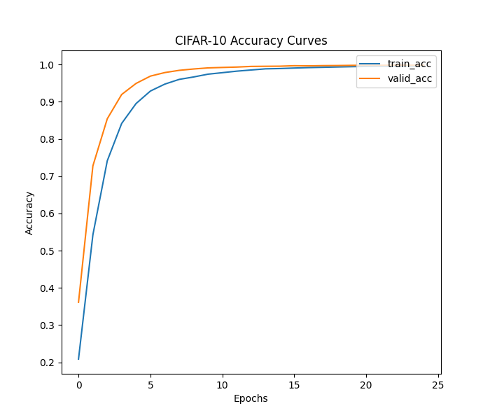
Exp2: 256 batch-size, 3GPUs

Slide 31
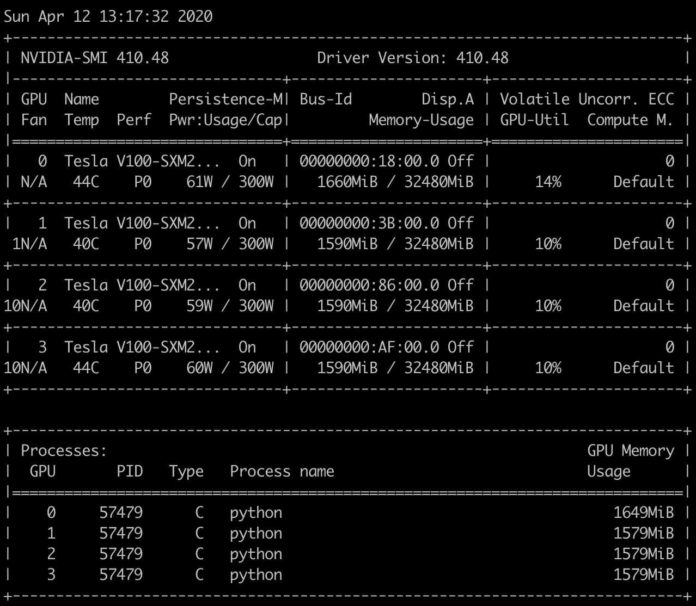
Experiment 2
Batch size: 256
GPU=4
Data Parallelism = Yes Training: 300
Validation: 34
Testing: 7

Slide 32
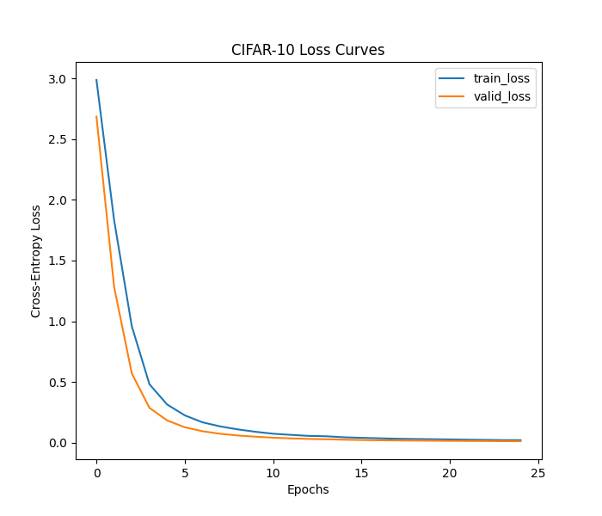
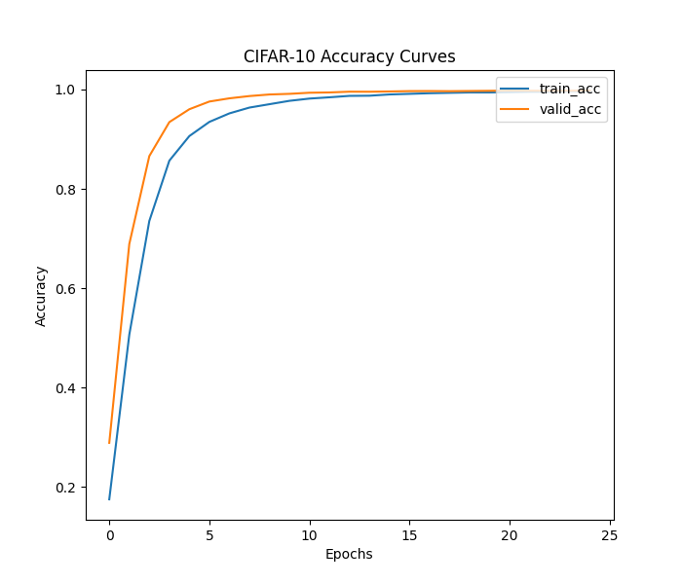
Exp2: 256 batch-size, 4GPUs

Slide 33

Experiment 3
Batch size: 512
GPU=1
Data Parallelism = No Training: 150
Validation: 17
Testing: 4

Slide 34
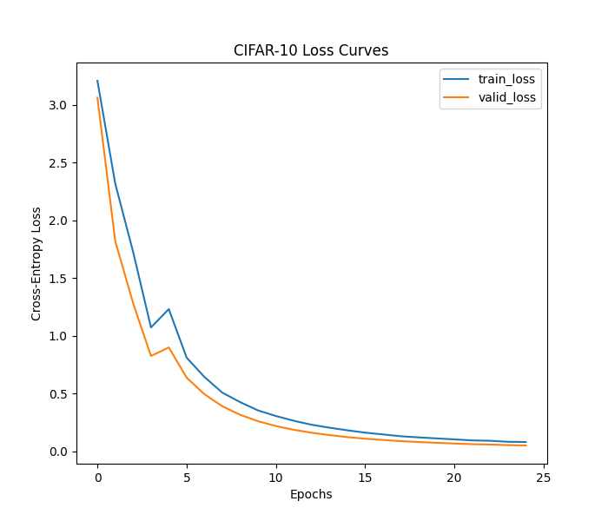
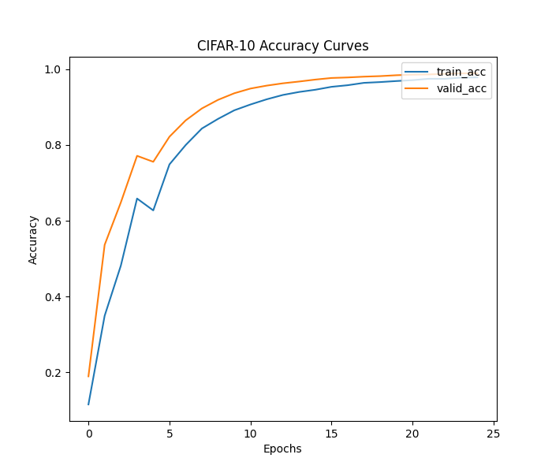
Exp3: 512 batch-size, 1GPU

Slide 35
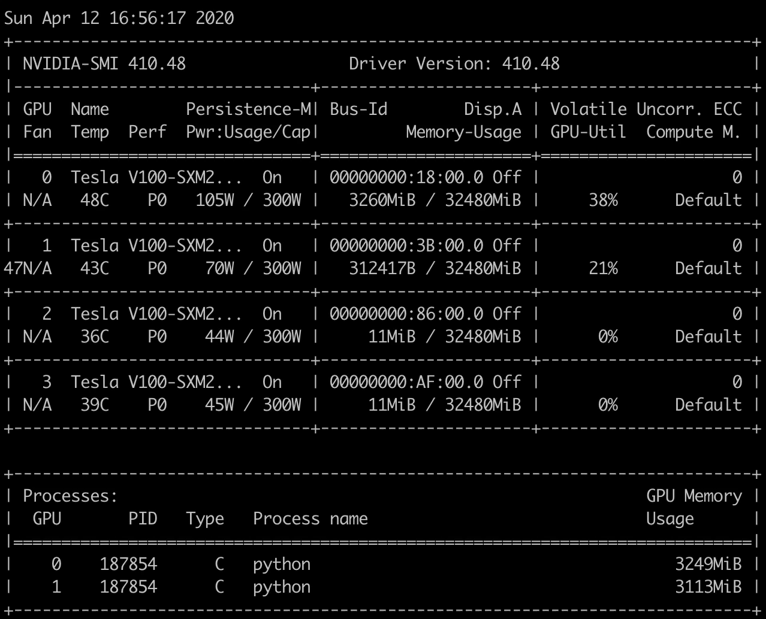
Experiment 3
Batch size: 512
GPU=2
Data Parallelism = Yes Training: 150
Validation: 17
Testing: 4

Slide 36
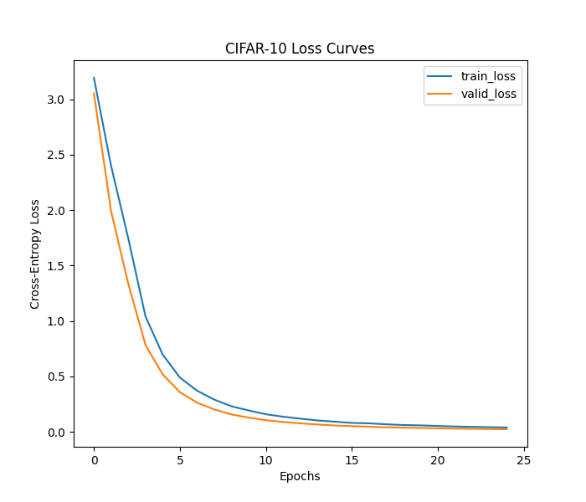
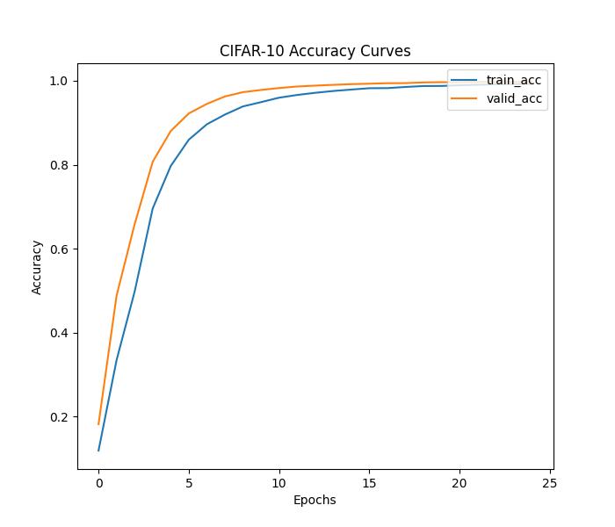
Exp3: 512 batch-size, 2GPUs

Slide 37
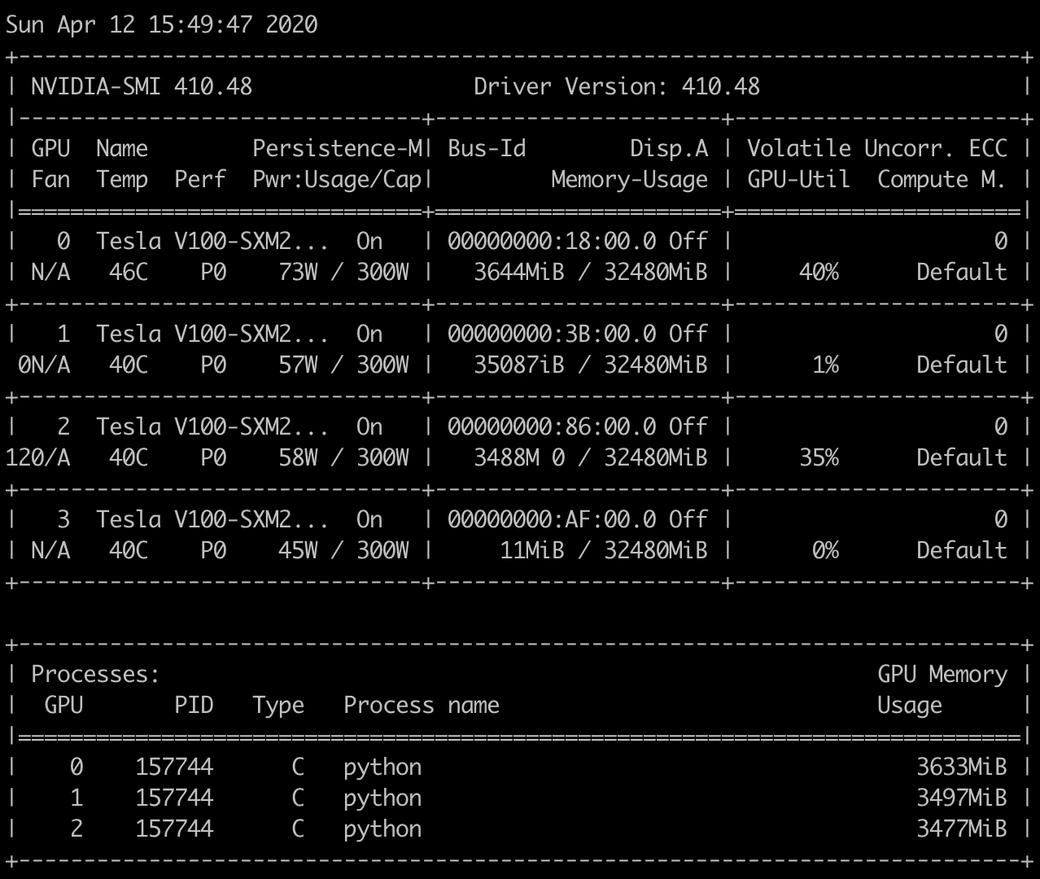
Experiment 3
Batch size: 512
GPU=3
Data Parallelism = Yes Training: 150
Validation: 17
Testing: 4

Slide 38
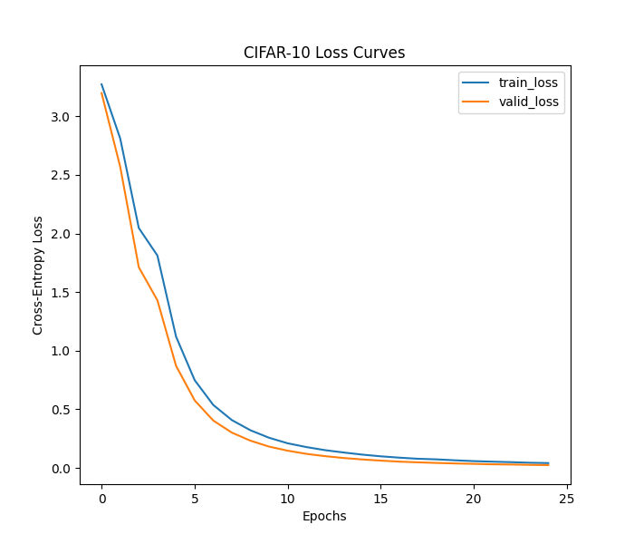
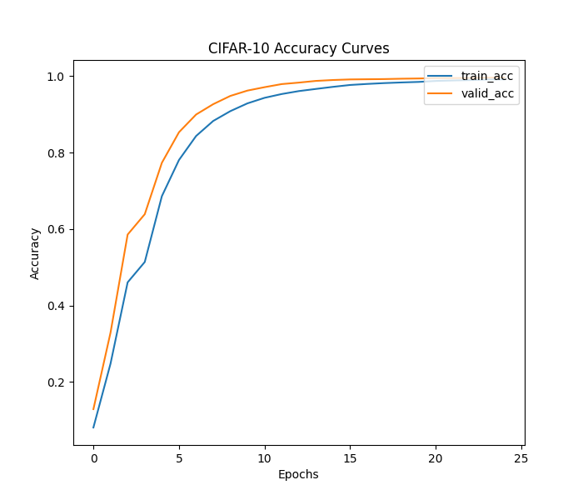
Exp3: 512 batch-size, 3GPUs

Slide 39
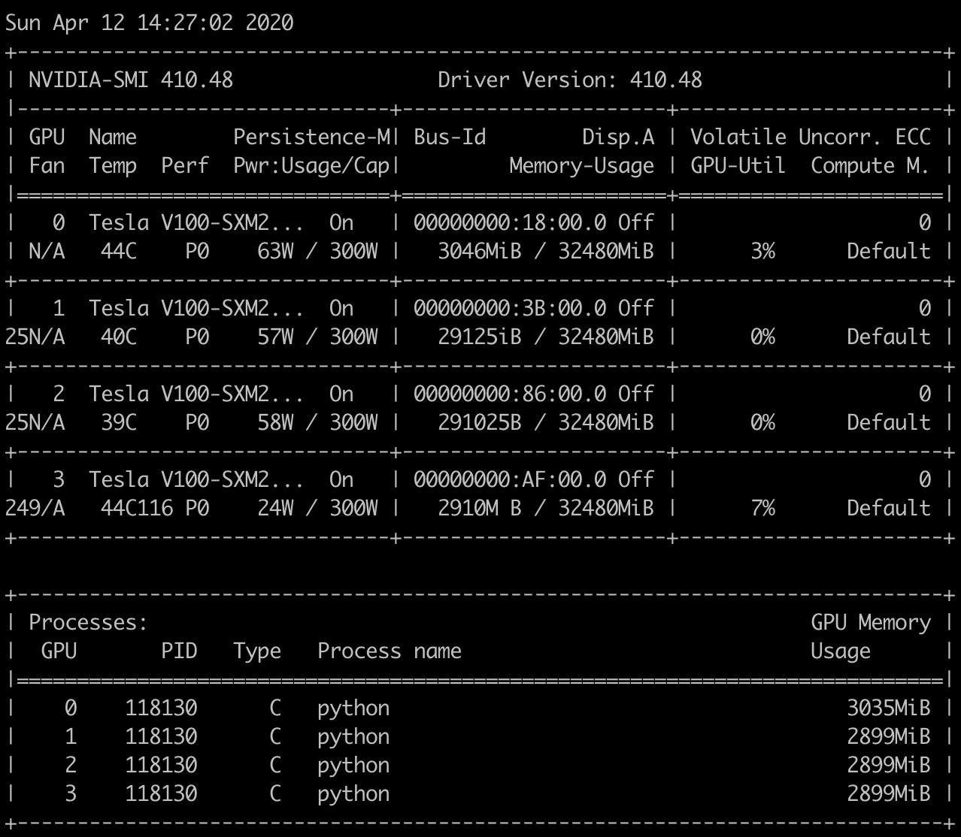
Experiment 3
Batch size: 512
GPU=4
Data Parallelism = Yes Training: 150
Validation: 17
Testing: 4

Slide 40
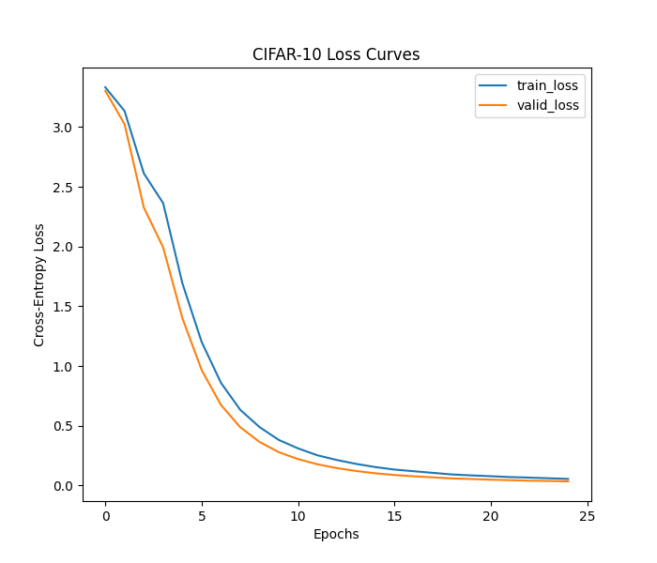
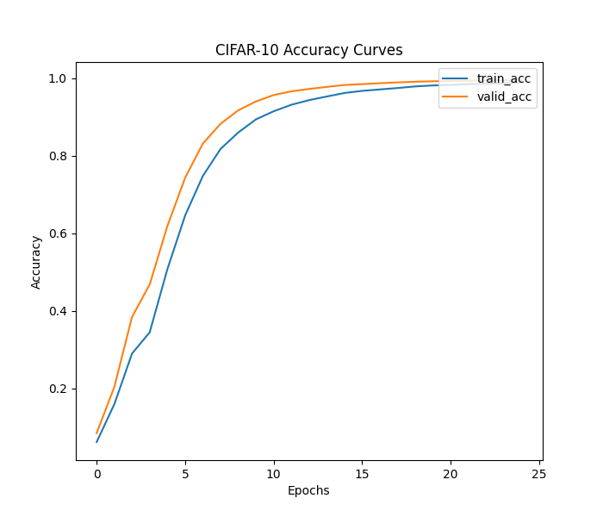
Exp3: 512 batch-size, 4GPUs

Slide 41
Summary or results
Experiment 1 | GPU 0 (GB) | GPU 1 (GB) | GPU 2 (GB) | GPU 3 (GB) | Exec. Time (secs) | Data Parallel | Train Acc | Valid Acc | Test Acc
Using 1GPU | 2.859 | NA | NA | NA | 2500.82 | No | 99.87 | 99.91 | 99.88
Using 2GPU | 1.569 | 1.531 | NA | NA | 2306.56 | Yes | 99.89 | 99.95 | 100.0
Using 3GPU | 1.419 | 1.381 | 1.373 | NA | 2296.49 | Yes | 99.84 | 99.90 | 99.88
Using 4GPU | 1.355 | 1.317 | 1.317 | 1.317 | 2335.14 | Yes | 99.86 | 99.88 | 99.94
Experiment 2 | GPU 0 (GB) | GPU 1 (GB) | GPU 2 (GB) | GPU 3 (GB) | Exec. Time (secs) | Data Parallel | Train Acc | Valid Acc | Test Acc
Using 1GPU | 2.859 | NA | NA | NA | 2461.46 | No | 99.66 | 99.87 | 99.88
Using 2GPU | 2.921 | 2.851 | NA | NA | 2360.52 | Yes | 99.71 | 99.88 | 99.71
Using 3GPU | 1.809 | 1.739 | 1.719 | NA | 2028.72 | Yes | 99.64 | 99.82 | 99.82
Using 4GPU | 1.649 | 1.579 | 1.579 | 1.579 | 2350.78 | Yes | 99.86 | 99.88 | 99.94
Experiment 3 | GPU 0 (GB) | GPU 1 (GB) | GPU 2 (GB) | GPU 3 (GB) | Exec. Time (secs) | Data Parallel | Train Acc | Valid Acc | Test Acc
Using 1GPU | 7.403 | NA | NA | NA | 2674.47 | No | 97.86 | 98.93 | 98.62
Using 2GPU | 3.219 | 3.113 | NA | NA | 2417.13 | Yes | 99.25 | 99.77 | 99.71
Using 3GPU | 3.633 | 3.497 | 3.477 | NA | 2218.39 | Yes | 99.19 | 99.67 | 99.42
Using 4GPU | 3.035 | 2.899 | 2.899 | 2.899 | 2329.82 | Yes | 98.91 | 99.53 | 99.42

Slide 42
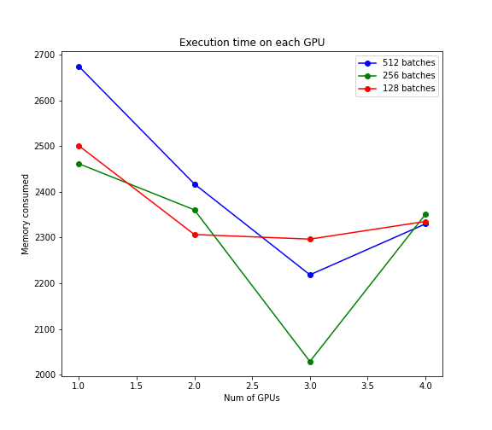
Observation 1
Using more GPU’s does not necessarily improve performance. There is a sweet spot where for a specific batch size we get good performance.
In the figure, 256 batches with 3 GPUs in Data Parallelism performs best.
Hypothesis 2: Using more GPU’s always speeds up computation and saves time.
Increasing GPUs does not always increase performance of model and hence alternate hypothesis is true.

Slide 43
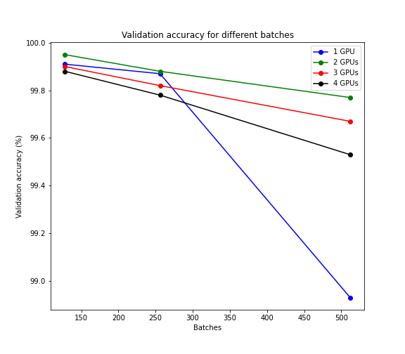
Observation 2
Using larger batches does not necessarily improve accuracy or model approximation capabilities. In fact more the batch size, lesser the generalization capabilities in our case.
In the figure, 128 batches with 2 GPUs in Data Parallelism performs best.
Hypothesis 3: Larger batch size means better model approximation.
Larger Batch size does not always lead to better model approximation. Hence the alternate hypothesis is true

Slide 44
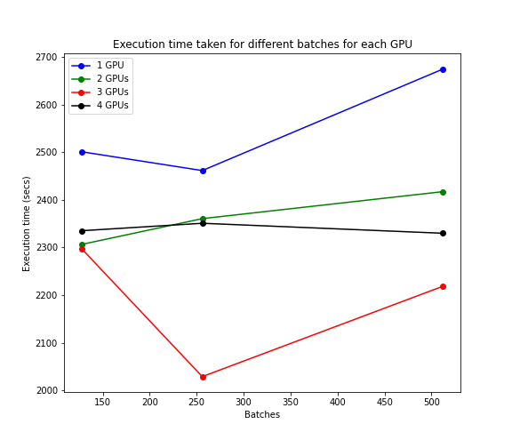
Observation 3
Execution time is optimal for a particular value of batch size.
In the figure, 256 batches seems to be the optimal batch size for Data Parallelism followed by 128 batches.
Hypothesis 4: Keeping number of GPUs constant, there exists a linear relationship between number of batches and time taken. In short, as number of batches increases, time decreases.
The alternate hypothesis holds true for this case. There does not exist any specific relationship and factors like GPU memory and dataset size play an important role.

Slide 45




Observation 4
Performance of the model is exceptional with a few false classifications
A Real time system is yet to be implemented
Hypothesis 1: We can recognize hand signs from images or stream of images using state of the art techniques.
Yes, we can develop a good system using state-of-the art methods for recognizing hand signs.

Slide 46
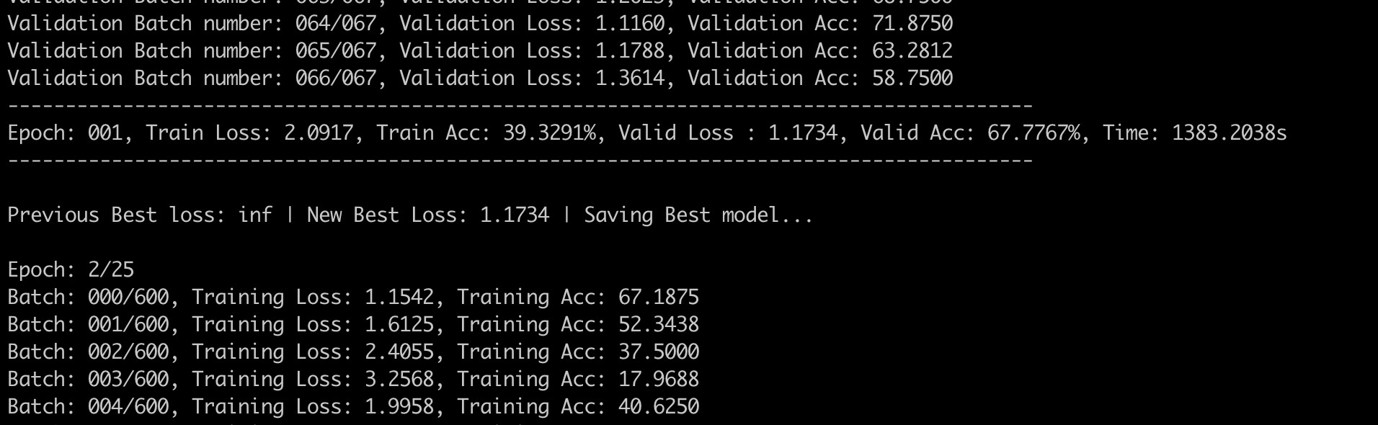
CPU Performance

Slide 47
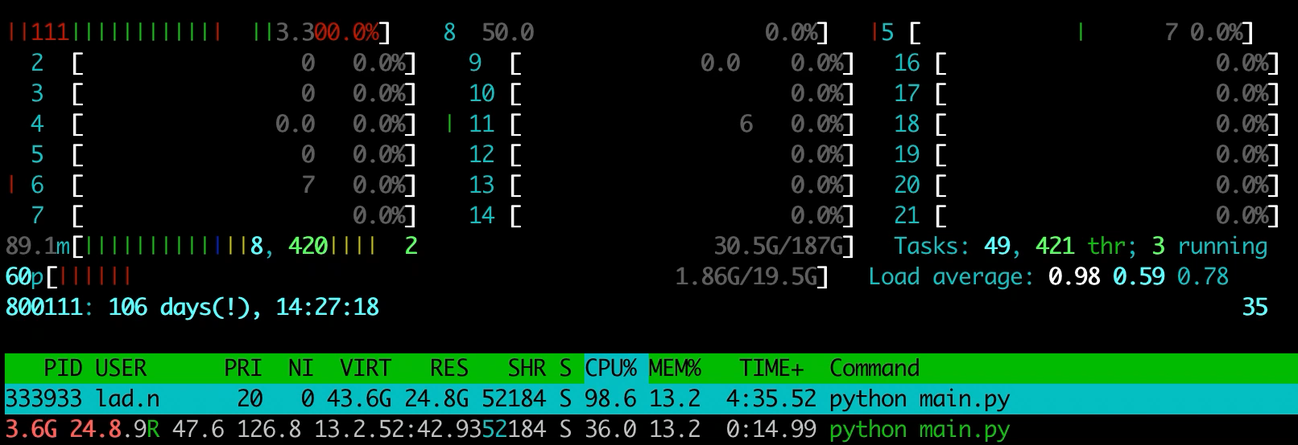
CPU Performance

Slide 48
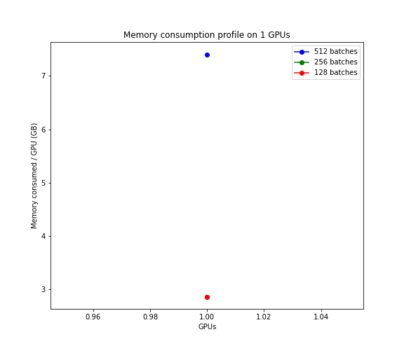
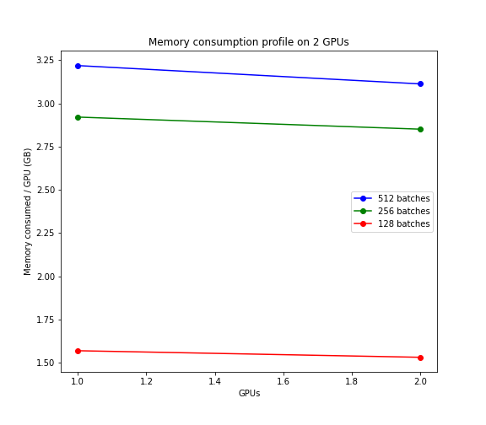
Memory Usage (Using 1 and 2 GPU)

Slide 49
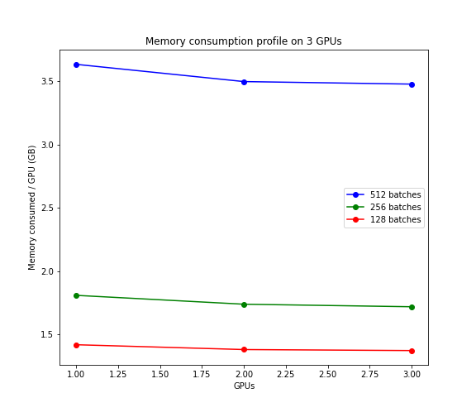
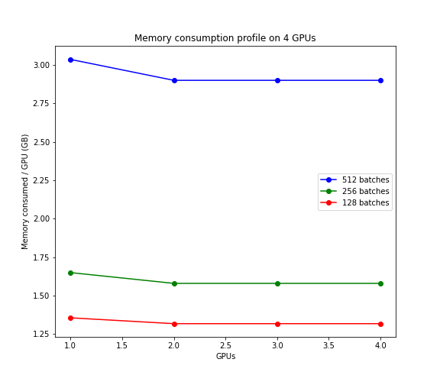
Memory Usage (3 and 4 GPUs)

Slide 50
Conclusion
There exists a good tradeoff between number of batches and num of GPUs to be used in parallel.
Time and memory are both important. Based on the above experiments, there is a clear under usage of GPU resources and maybe spinning a smaller GPU would have helped me.
We need to used up to 90-95% of GPU memory and only if a batch does not fit a memory, we should use Data Parallelism.
256 Batches, with 3 GPUs in data parallelism performs best with a total of 5.267GB of memory being consumed.

Slide 51
References
S. P. More and A. Sattar, "Hand gesture recognition system using image processing," 2016 International Conference on Electrical, Electronics, and Optimization Techniques (ICEEOT), Chennai, 2016, pp. 671-675.
Y. Lecun, L. Bottou, Y. Bengio and P. Haffner, "Gradient-based learning applied to document recognition," in Proceedings of the IEEE, vol. 86, no. 11, pp. 2278-2324, Nov. 1998.
Imagenet classification with deep convolutional neural networks, A Krizhevsky, I Sutskever, GE Hinton - Advances in neural information processing systems, 2012
Measuring the effects of data parallelism on neural network training, CJ Shallue, J Lee, J Antognini, J Sohl-Dickstein… - arXiv preprint arXiv:1811.03600, 2018
On model parallelization and scheduling strategies for distributed machine learning, S Lee, JK Kim, X Zheng, Q Ho, GA Gibson, EP Xing - Advances in neural information processing systems, 2014

Slide 52
THANK YOU

